Slide 1
W4111 – Introduction to Databases Section 002, Fall 2021 Lecture 4: ER, Relational, SQL (III)
© Donald F. Ferguson, 2021

Slide 2

Contents
2 | Introduction to Databases (F21): Lecture 4: ER, Relational, SQL (III) © Donald F. Ferguson, 2021

Slide 3
Contents
Questions, answers, discussion.
A worked example involving:
ER modeling.
SQL DDL and data model creation.
Top-down and bottom-up modeling.
A little more relational algebra and the dreaded “RelaX Calculator.”
SQL Insert, Update and Delete.

Slide 4
Questions, Answers, Discussion
4 | Introduction to Databases (F21): Lecture 4: ER, Relational, SQL (III) © Donald F. Ferguson, 2021

Slide 5
Systematic Treatment of NULL
From Ed Discussion:
“Confusion: When looking over the W4111_hw1_material.ipynb file, it's mentioned that "isDead is either true or NULL. NULL means unknown or not applicable". But, in the spec for the HW, it says that the column should strictly take 'Y' or 'N' values. The example output also generated confusion since it did include 'N' in the isDead column.
Question: Regardless, I understand any column can take NULL values but I just wanted to make sure we should only include 'Y' and NULL as values in our column where the latter is instead of 'N'. Should we use 'true' rather than 'Y' as the HW 1 materials file specifies as well?”
Comments:
IMHO the question is focusing on your understanding type constraints and data cleanup. So, “Y” or “N” is fine with me.
That aside, my solution would be true or NULL.
The data does indicate is someone is dead, but ... ...
The data is “old.” I cannot be sure someone is alive. They could have just died.

Slide 6
Codd’s 12 Rules
Rule 1: Information Rule
The data stored in a database, may it be user data or metadata, must be a value of some table cell. Everything in a database must be stored in a table format.
Rule 2: Guaranteed Access Rule
Every single data element (value) is guaranteed to be accessible logically with a combination of table-name, primary-key (row value), and attribute-name (column value). No other means, such as pointers, can be used to access data.
Rule 3: Systematic Treatment of NULL Values
The NULL values in a database must be given a systematic and uniform treatment. This is a very important rule because a NULL can be interpreted as one the following − data is missing, data is not known, or data is not applicable.
Rule 4: Active Online Catalog
The structure description of the entire database must be stored in an online catalog, known as data dictionary, which can be accessed by authorized users. Users can use the same query language to access the catalog which they use to access the database itself.
Rule 5: Comprehensive Data Sub-Language Rule
A database can only be accessed using a language having linear syntax that supports data definition, data manipulation, and transaction management operations. This language can be used directly or by means of some application. If the database allows access to data without any help of this language, then it is considered as a violation.
Rule 6: View Updating Rule
All the views of a database, which can theoretically be updated, must also be updatable by the system.

Slide 7
Codd’s 12 Rules
Rule 7: High-Level Insert, Update, and Delete Rule
A database must support high-level insertion, updation, and deletion. This must not be limited to a single row, that is, it must also support union, intersection and minus operations to yield sets of data records.
Rule 8: Physical Data Independence
The data stored in a database must be independent of the applications that access the database. Any change in the physical structure of a database must not have any impact on how the data is being accessed by external applications.
Rule 9: Logical Data Independence
The logical data in a database must be independent of its user’s view (application). Any change in logical data must not affect the applications using it. For example, if two tables are merged or one is split into two different tables, there should be no impact or change on the user application. This is one of the most difficult rule to apply.
Rule 10: Integrity Independence
A database must be independent of the application that uses it. All its integrity constraints can be independently modified without the need of any change in the application. This rule makes a database independent of the front-end application and its interface.
Rule 11: Distribution Independence
The end-user must not be able to see that the data is distributed over various locations. Users should always get the impression that the data is located at one site only. This rule has been regarded as the foundation of distributed database systems.
Rule 12: Non-Subversion Rule
If a system has an interface that provides access to low-level records, then the interface must not be able to subvert the system and bypass security and integrity constraints.

Slide 8
Codd’s 12 Rules
Rule 3: Systematic treatment of null values:
“Null values (distinct from the empty character string or a string of blank characters and distinct from zero or any other number) are supported in fully relational DBMS for representing missing information and inapplicable information in a systematic way, independent of data type.”
Sometimes programmers and database designers are tempted to use “special values” to indicate unknow, missing or inapplicable values.
String: “”, “NA”, “UNKNOWN”, ...
Numbers: -1, 0, -9999
Indicators can cause confusion because you have to carefully code some SQL statements to the specific, varying choices programmers made.

Slide 9
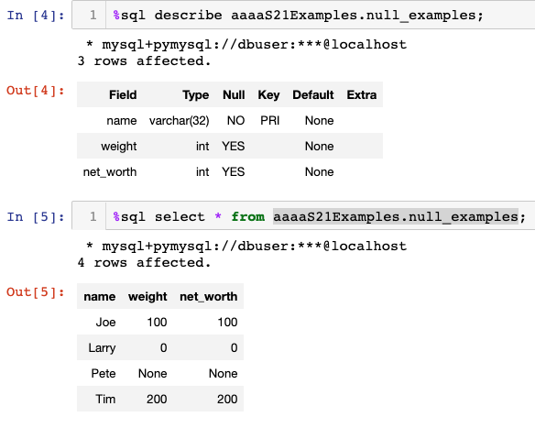
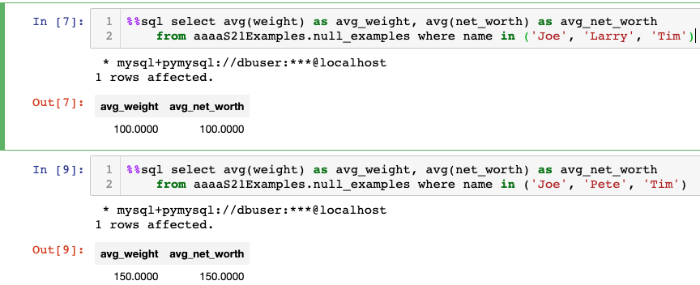
NULL and Correct Answers
Without NULL, to get a correct answer:
I must understand the domain to determine “unknown” values or know what choice a developer made.
Explicitly include “where weight != 0” in all statements.
And this varies from column to column, table to table, schema to schema, etc.

Slide 10
Back to Our Excellent Question
“When deathYear is null do we assume that the person is alive? What if he is dead and information is just missing?”
Well,
My interpretation is that if there is no death date, isDead should be NULL.
I might expect that the person is dead if their current age would be 125, but that is just a guess.
Also,
Having a column isDead is actually a bad design pattern in this case.
The value of isDead is functionally dependent on deathYear.
Database designs avoid functional dependencies to prevent update anomalies. Some could forget to update both columns when learning a fact.
In other scenarios, I might know that a person isDead but not know the deathDate. So, this design decision is problem/scenario specific.

Slide 11
Other Questions?

Slide 12
Worked Example:
ER Model from scratch.
Schema definition, DDL, ... and some new concepts.
Where’s the data?
12 | Introduction to Databases (F21): Lecture 4: ER, Relational, SQL (III) © Donald F. Ferguson, 2021

Slide 13

Worked Example – Top Down
Scenario
Course with complex course ID.
Section
Faculty
Department
Instructor – Department Assoc. entity with properties (role, date).
Instructor – Section
Student - Section
Do ER (live) diagram in Lucidchart.
Do schema creation
In DataGrip
Show copying statements int the notebook.
No laughing when I make
mistakes!

Slide 14
CREATE TABLE `cu_model`.`courses` (
`dept_code` VARCHAR(4) NOT NULL,
`faculty_code` ENUM('BC', 'C', 'W', 'E', 'G') NOT NULL,
`credit_level` ENUM('0', '1', '2', '3', '4', '6', '8', '9') NOT NULL,
`course_no` VARCHAR(3) NOT NULL,
`title` VARCHAR(64) NOT NULL,
`full_course_no` VARCHAR(12) GENERATED ALWAYS AS (concat(dept_code,faculty_code,credit_level,course_no)),
PRIMARY KEY (`dept_code`, `faculty_code`, `credit_level`, `course_no`));

Slide 15
Bottom-Up: Some Sources of Information
Course Codes: https://www.cc-seas.columbia.edu/sites/dsa/files/handbooks/Columbia%20Key%20to%20Course%20Listing.pdf
Course/Section Properties: http://www.columbia.edu/cu/bulletin/uwb/
Common Search Criteria → Indexes, Query Parameters, Data Links https://doc.search.columbia.edu/classes/Ferguson?instr=&name=&days=&semes=&hour=&moi=
Department Information:
Script: https://www.columbia.edu/content/academics/departments
Codes: https://academic-admin.cuit.columbia.edu/dept_code
Specific Information:
Course and Instructor: https://opendataservice.columbia.edu/api/9/json
Vergil Data: https://vergil.registrar.columbia.edu/feeds/cw.js
Vergil Search: https://vergil.registrar.columbia.edu/doc-adv-queries.php?key=ferguson&moreresults=2

Slide 16
Meet in the Middle
Show cu_info project with data and processing.
Show notebook for loading the data.
Show getting part of the way through parsing HTML in project

Slide 17
Some More Relational Algebra
17 | Introduction to Databases (F21): Lecture 4: ER, Relational, SQL (III) © Donald F. Ferguson, 2021

Slide 18
Union Operation
The union operation allows us to combine two relations
Notation: r ∪ s
For r ∪ s to be valid.
1. r, s must have the same arity (same number of attributes)
2. The attribute domains must be compatible (example: 2nd
column of r deals with the same type of values as does the 2nd column of s)
Example: to find all courses taught in the Fall 2017 semester, or in the Spring 2018 semester, or in both ∏_{course_id} (σ _{semester=“Fall” Λ year=2017} (section)) ∪ ∏_{course_id} (σ _{semester=“Spring” Λ year=2018} (section))

Slide 19
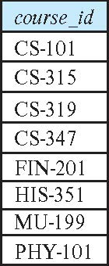
Union Operation (Cont.)
Result of: ∏_{course_id} (σ _{semester=“Fall” Λ year=2017} (section)) ∪ ∏_{course_id} (σ _{semester=“Spring” Λ year=2018} (section))
Note: The preloaded dataset on the RelaX calculator is different from the most recent data referenced in the book. It is from a previous edition.

Slide 20
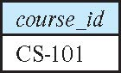
Set-Intersection Operation
The set-intersection operation allows us to find tuples that are in both the input relations.
Notation: r ∩ s
Assume:
r, s have the same arity
attributes of r and s are compatible
Example: Find the set of all courses taught in both the Fall 2017 and the Spring 2018 semesters.
∏_{course_id} (σ _{semester=“Fall” Λ year=2017} (section)) ∩ ∏_{course_id} (σ _{semester=“Spring” Λ year=2018} (section))
Result

Slide 21
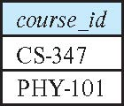
Set Difference Operation
The set-difference operation allows us to find tuples that are in one relation but are not in another.
Notation r – s
Set differences must be taken between compatible relations.
r and s must have the same arity
attribute domains of r and s must be compatible
Example: to find all courses taught in the Fall 2017 semester, but not in the Spring 2018 semester ∏_{course_id} (σ _{semester=“Fall” Λ year=2017} (section)) − ∏_{course_id} (σ _{semester=“Spring” Λ year=2018} (section))

Slide 22
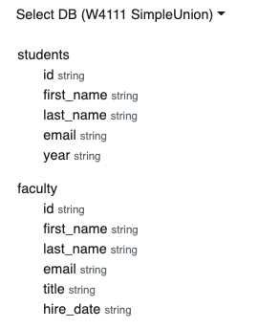
Same “arity”
Same “arity”
Same number of columns.
Compatible types.
The i-th column in each table is from a compatible domain.
Student 5th column is “year.”
Faculty 5th column is “title”
Both are strings but combing them does not make sense.
You can shape two incompatible tables using project operations. For example
π first_name,last_name,email (students) ∩ π first_name,last_name,email (faculty)
π last_name,email, title←'Student' (students) ∪ π last_name,email, title (faculty)

Slide 23
The Assignment Operation
It is convenient at times to write a relational-algebra expression by assigning parts of it to temporary relation variables.
The assignment operation is denoted by ← and works like assignment in a programming language.
Example: Find all instructor in the “Physics” and Music department. Physics ← σ _{dept_name=“Physics”} (instructor)
Music ← σ _{dept_name=“Music”} (instructor)
Physics ∪ Music
With the assignment operation, a query can be written as a sequential program consisting of a series of assignments followed by an expression whose value is displayed as the result of the query.

Slide 24
The Rename Operation
The results of relational-algebra expressions do not have a name that we can use to refer to them. The rename operator, ρ , is provided for that purpose
The expression:
ρ_{x} (E)
returns the result of expression E under the name x
Another form of the rename operation:
ρ_{x(A1,A2, .. An)} (E)
Note: Assignment and rename can act a little wonky when using the calculator.

Slide 25
Equivalent Queries
There is more than one way to write a query in relational algebra.
Example: Find information about courses taught by instructors in the Physics department with salary greater than 90,000
Query 1
σ _{dept_name=“Physics”} ∧ _{salary > 90,000} (instructor)
Query 2
σ _{dept_name=“Physics”} (σ _{salary > 90.000} (instructor))
The two queries are not identical; they are, however, equivalent -- they give the same result on any database.

Slide 26
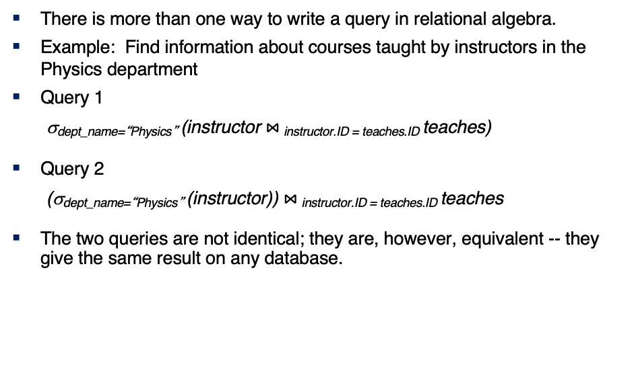
Equivalent Queries
There is more than one way to write a query in relational algebra.
Example: Find information about courses taught by instructors in the Physics department
Query 1
σ_{dept_name=“Physics”} (instructor $⋈_{ }$_{instructor.ID = teaches.ID} teaches)
Query 2
(σ_{dept_name=“Physics”} (instructor)) $⋈_{ }$_{instructor.ID = teaches.ID} teaches
The two queries are not identical; they are, however, equivalent -- they give the same result on any database.

Slide 27
Insert, Update, Delete
27 | Introduction to Databases (F21): Lecture 4: ER, Relational, SQL (III) © Donald F. Ferguson, 2021

Slide 28
Modification of the Database
Deletion of tuples from a given relation.
Insertion of new tuples into a given relation
Updating of values in some tuples in a given relation

Slide 29
Copying Data Examples
/* Copy data but not keys, etc. */
create table department_backup as
select * from department;
/* Make an empty table lust like ... Including keys, etc. */
create table department_backup_cool like department;
/* Insert the result of the select into the table. */
insert into department_backup_cool select * from department;
/* Safe way to change data with aggregates in the where ... */
set @avg = (select avg(salary) from instructor);
select * from instructor where salary > @avg;

Slide 30
Deletion
Delete all instructors
delete from instructor
Delete all instructors from the Finance department delete from instructor where dept_name= 'Finance’;
Delete all tuples in the instructor relation for those instructors associated with a department located in the Watson building.
delete from instructor where dept name in (select dept name from department where building = 'Watson');

Slide 31
Deletion (Cont.)
Delete all instructors whose salary is less than the average salary of instructors
Problem: as we delete tuples from instructor, the average salary changes
Solution used in SQL:
First, compute avg (salary) and find all tuples to delete
Next, delete all tuples found above (without recomputing avg or retesting the tuples)
delete from instructor
where salary < (select avg (salary)
from instructor);

Slide 32
Insertion
Add a new tuple to course
insert into course values ('CS-437', 'Database Systems', 'Comp. Sci.', 4);
or equivalently
insert into course (course_id, title, dept_name, credits) values ('CS-437', 'Database Systems', 'Comp. Sci.', 4);
Add a new tuple to student with tot_creds set to null
insert into student values ('3003', 'Green', 'Finance', null);

Slide 33
Equivalent
insert into student values ('3003', 'Green', 'Finance', null);
insert into student(dept_name, ID, name)
values('Finance', '3003', 'Green');

Slide 34
Insertion (Cont.)
Make each student in the Music department who has earned more than 144 credit hours an instructor in the Music department with a salary of $18,000.
insert into instructor select ID, name, dept_name, 18000 from student where dept_name = 'Music' and total_cred > 144;
The select from where statement is evaluated fully before any of its results are inserted into the relation.
Otherwise queries like
insert into table1 select * from table1
would cause problem

Slide 35
Updates
Give a 5% salary raise to all instructors
update instructor set salary = salary * 1.05
Give a 5% salary raise to those instructors who earn less than 70000 update instructor set salary = salary * 1.05 where salary < 70000;
Give a 5% salary raise to instructors whose salary is less than average
update instructor set salary = salary * 1.05 where salary < (select avg (salary) from instructor);

Slide 36
Updates (Cont.)
Increase salaries of instructors whose salary is over $100,000 by 3%, and all others by a 5%
Write two update statements:
update instructor set salary = salary * 1.03 where salary > 100000; update instructor set salary = salary * 1.05 where salary <= 100000;
The order is important
Can be done better using the case statement (next slide)
Fixed
Exec
Fixed 2

Slide 37
Case Statement for Conditional Updates
Same query as before but with case statement
update instructor set salary = case when salary <= 100000 then salary * 1.05 else salary * 1.03 end

Slide 38
Updates with Scalar Subqueries
Recompute and update tot_creds value for all students
update student S set tot_cred = (select sum(credits) from takes, course where takes.course_id = course.course_id and S.ID= takes.ID.and takes.grade <> 'F' and takes.grade is not null);
Sets tot_creds to null for students who have not taken any course
Instead of sum(credits), use:
case when sum(credits) is not null then sum(credits) else 0 end

Slide 39
Summary
INSERT, UPDATE and DELETE are pretty straightforward.
UPDATE and DELETE are very similar to SELECT
WHERE clause specifies which rows are affected.
The SELECT choose the columns to return.
The SET clause chooses and changes columns.
DELETE just removes the specified rows.
INSERT, UPDATE and DELETE changes must not violate constraints, e.g.
INSERT a row that causes a duplicate key.
DELETE a referenced (target) foreign key.
UPDATE columns that create a duplicate key.
INSERT values do not include all NOT NULL columns.
I am not going to do example now, but you have seen and will see me do examples in the context of larger examples.

Slide 40
JOINs
40 | Introduction to Databases (F21): Lecture 4: ER, Relational, SQL (III) © Donald F. Ferguson, 2021

Slide 41
Joined Relations
Join operations take two relations and return as a result another relation.
A join operation is a Cartesian product which requires that tuples in the two relations match (under some condition). It also specifies the attributes that are present in the result of the join
The join operations are typically used as subquery expressions in the from clause
Three types of joins:
Natural join
Inner join
Outer join
Notes:
You will also hear terms like equi-join, non-equi-join, theta join, semi-join, ... ...
I ask for definitions on exams, but you can just look them up.

Slide 42
Natural Join in SQL
Natural join matches tuples with the same values for all common attributes, and retains only one copy of each common column.
List the names of instructors along with the course ID of the courses that they taught
select name, course_id from students, takes where student.ID = takes.ID;
Same query in SQL with “natural join” construct
select name, course_id from student natural join takes;

Slide 43
Natural Join in SQL (Cont.)
The from clause can have multiple relations combined using natural join:
select A₁, A₂, … A_{n} from r₁ natural join r₂ natural join .. natural join r_{n} where P ;

Slide 44
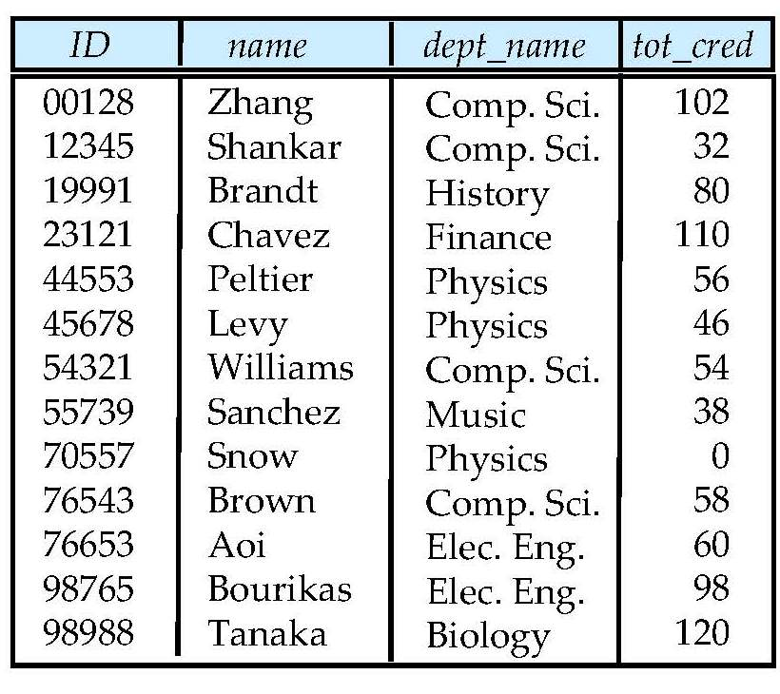
Student Relation

Slide 45
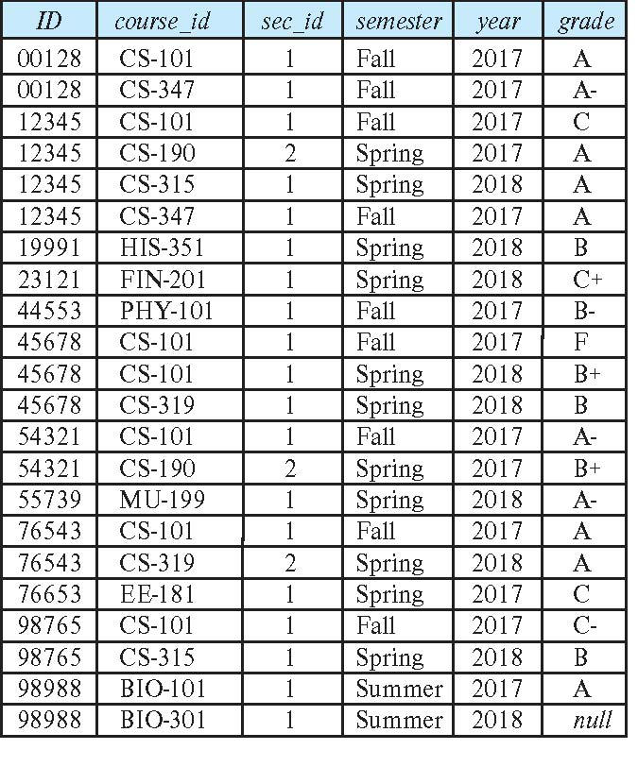
Takes Relation

Slide 46
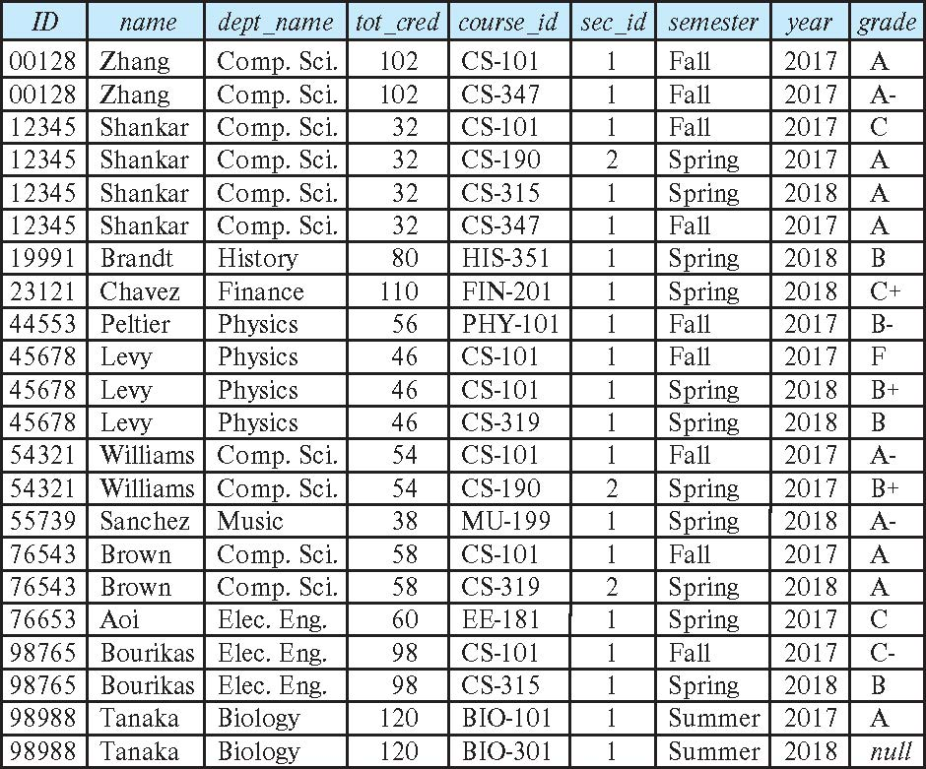
student natural join takes

Slide 47
Dangerous in Natural Join
Beware of unrelated attributes with same name which get equated incorrectly
Example -- List the names of students’ instructors along with the titles of courses that they have taken
Correct version
select name, title from student natural join takes, course where takes.course_id = course.course_id;
Incorrect version
select name, title from student natural join takes natural join course;
This query omits all (student name, course title) pairs where the student takes a course in a department other than the student's own department.
The correct version (above), correctly outputs such pairs.

Slide 48
Natural Join with Using Clause
To avoid the danger of equating attributes erroneously, we can use the “using” construct that allows us to specify exactly which columns should be equated.
Query example
select name, title from (student natural join takes) join course using (course_id)

Slide 49
Join Condition
The on condition allows a general predicate over the relations being joined
This predicate is written like a where clause predicate except for the use of the keyword on
Query example
select * from student join takes on student_ID = takes_ID
The on condition above specifies that a tuple from student matches a tuple from takes if their ID values are equal.
Equivalent to:
select * from student , takes where student_ID = takes_ID

Slide 50
Join Condition (Cont.)
The on condition allows a general predicate over the relations being joined.
This predicate is written like a where clause predicate except for the use of the keyword on.
Query example
select * from student join takes on student_ID = takes_ID
The on condition above specifies that a tuple from student matches a tuple from takes if their ID values are equal.
Equivalent to:
select * from student , takes where student_ID = takes_ID

Slide 51
One Way to Think About Joins

Slide 52
Let’s Do Some Example
Theta Join: Find people in Lahman’s DB who appeared (played) after Managing.
Show in Jupyter Notebook
Players who played for the Boston Red Sox in 1967, and their Hall of Fame information if it exists.
Show in Jupyter Notebook
Emulating full outer join:
The basic id is union left join and a right join
(select * from x left join y) union (select * from x right join y)

Slide 53

Set Operations
53 | COMS W4111_002_2021_1: Lecture 3: ER, Relational, SQL (III) © Donald F. Ferguson, 2021

Slide 54
Set Operations

Slide 55
Set Operations (Cont.)
Set operations union, intersect, and except
Each of the above operations automatically eliminates duplicates
To retain all duplicates use the
union all,
intersect all
except all.
NOTE:
SELECT implementing a project can have duplicate rows. If you do not want duplicates, you must use the DISTINCT key word.
UNION behaves the other way. It removes duplicates. If you want to keep the duplicates, you have to select UNION ALL.
Some SQL engines do not implement INTERSECT and/or EXCEPT, you can implement the function with subqueries, which we will cover soon.

Slide 56
Set Operations
Find courses that ran in Fall 2017 or in Spring 2018
(select course_id from section where sem = 'Fall' and year = 2017) union (select course_id from section where sem = 'Spring' and year = 2018)
Find courses that ran in Fall 2017 and in Spring 2018
(select course_id from section where sem = 'Fall' and year = 2017) intersect (select course_id from section where sem = 'Spring' and year = 2018)
Find courses that ran in Fall 2017 but not in Spring 2018
(select course_id from section where sem = 'Fall' and year = 2017) except (select course_id from section where sem = 'Spring' and year = 2018)

Slide 57
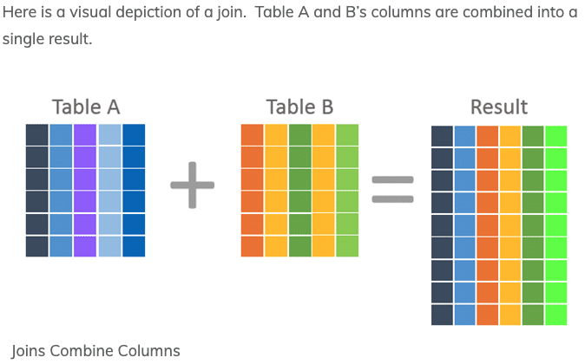
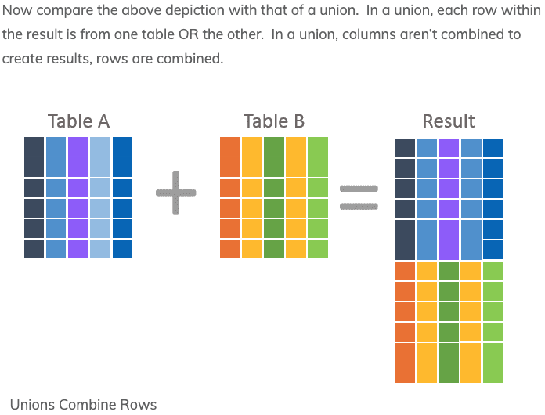
JOIN and UNION – A Final Word
UNION vs JOIN can be confusing. Basically,
JOIN puts the tables together “side by side.”
Union puts the tables together “one on top of the oter.”

Slide 58
Sub-Query
58 | COMS W4111_002_2021_1: Lecture 3: ER, Relational, SQL (III) © Donald F. Ferguson, 2021

Slide 59
Nested Subqueries
SQL provides a mechanism for the nesting of subqueries. A subquery is a select-from-where expression that is nested within another query.
The nesting can be done in the following SQL query select A₁, A₂, ..., A_{n} from r₁, r₂, ..., r_{m} where P
as follows:
From clause: r_{i} can be replaced by any valid subquery
Where clause: P can be replaced with an expression of the form:
B <operation> (subquery)
B is an attribute and <operation> to be defined later.
Select clause:
A_{i} can be replaced be a subquery that generates a single value.
Note:
This is a little cryptic.
I think I know what they mean.
There are some operations we will see later in the material, e.g IN, EXISTS, ... ...

Slide 60
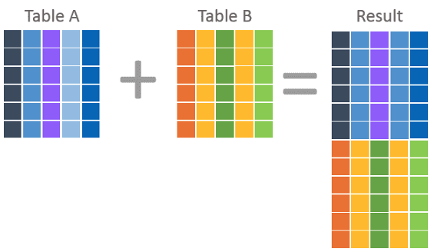
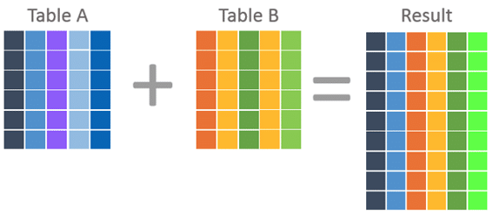
Nested Subquery
The slides that come with the book have surprisingly little material on nested subqueries.
The concept is:
Extremely important.
Students often find subqueries more confusing than joins.
The relationship/difference of subqueries to joins is often, initial unclear.
We have seen:
Union sort of puts a table on top of a table.
Join puts tables sort of puts tables side-by-side.
Subquery enables one query to call another during execution like a subfunction.

Slide 61
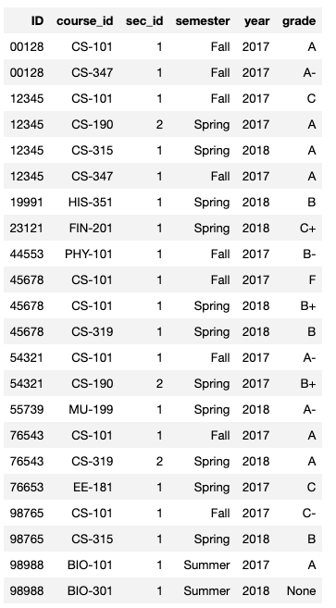
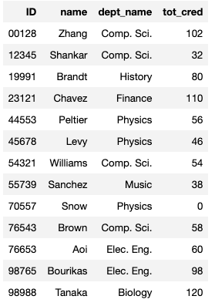
Consider Some Tables
Student
Takes

Slide 62
Consider a Subquery Tables
select *, (select name from student where student.id=takes.id) as name from takes;
Assume I wrote a function find_student_name(x)
Input is an x
Loops through all students and returns students with student.ID = x.
The query with a subquery above is like:
result = []
For t in takes:
new_r = t + find_student_name(t.id)
result.append(new_r)
Switch to Notebook
Takes
Student

Slide 63
Nested Subqueries
SQL provides a mechanism for the nesting of subqueries. A subquery is a select-from-where expression that is nested within another query.
The nesting can be done in the following SQL query select A₁, A₂, ..., A_{n} from r₁, r₂, ..., r_{m} where P
as follows:
From clause: r_{i} can be replaced by any valid subquery
Where clause: P can be replaced with an expression of the form:
B <operation> (subquery)
B is an attribute and <operation> to be defined later.
Select clause:
A_{i} can be replaced be a subquery that generates a single value.
Note: Subquery MUST return
A single scalar if in the SELECT.
A Table if in the FROM.
If in the WHERE:
Either a scalar or a table.
Depending on the operation.

Slide 64
Set Membership

Slide 65
Set Membership
Find courses offered in Fall 2017 and in Spring 2018
Find courses offered in Fall 2017 but not in Spring 2018
select distinct course_id
from section
where semester = 'Fall' and year= 2017 and course_id in (select course_id
from section
where semester = 'Spring' and year= 2018);
select distinct course_id
from section
where semester = 'Fall' and year= 2017 and course_id not in (select course_id
from section
where semester = 'Spring' and year= 2018);

Slide 66
Set Membership (Cont.)
Name all instructors whose name is neither “Mozart” nor Einstein”
select distinct name
from instructor
where name not in ('Mozart', 'Einstein')
Find the total number of (distinct) students who have taken course sections taught by the instructor with ID 10101
Note: Above query can be written in a much simpler manner. The formulation above is simply to illustrate SQL features
select count (distinct ID)
from takes
where (course_id, sec_id, semester, year) in (select course_id, sec_id, semester, year
from teaches
where teaches.ID= 10101);

Slide 67
Set Comparison

Slide 68
Set Comparison – “some” Clause
Find names of instructors with salary greater than that of some (at least one) instructor in the Biology department.
Same query using > some clause
select distinct T.name
from instructor as T, instructor as S
where T.salary > S.salary and S.dept name = 'Biology';
select name
from instructor
where salary > some (select salary
from instructor
where dept name = 'Biology');

Slide 69
Definition of “some” Clause
F <comp> some r ⇔ ∃ t ∈ r such that (F <comp> t ) Where <comp> can be: <, ≤, >, =, ≠
0
(5 < some
5
) = true
(read: 5 < some tuple in the relation)
6
0
(5 < some
5
) = false
0
(5 = some
) = true
5
0
(5 ≠ some
5
) = true (since 0 ≠ 5)
(= some) ≡ in
However, (≠ some) ≡ not in

Slide 70
Set Comparison – “all” Clause
Find the names of all instructors whose salary is greater than the salary of all instructors in the Biology department.
select name
from instructor
where salary > all (select salary
from instructor
where dept name = 'Biology');

Slide 71
Definition of “all” Clause
F <comp> all r ⇔ ∀ t ∈ r (F <comp> t)
0
(5 < all
5
) = false
6
6
(5 < all
) = true
10
4
(5 = all
) = false
5
4
(5 ≠ all
) = true (since 5 ≠ 4 and 5 ≠ 6)
6
(≠ all) ≡ not in
However, (= all) ≡ in

Slide 72
Test for Empty Relations
The exists construct returns the value true if the argument subquery is nonempty.
exists r ⇔ r ≠ Ø
not exists r ⇔ r = Ø

Slide 73
Use of “exists” Clause
Yet another way of specifying the query “Find all courses taught in both the Fall 2017 semester and in the Spring 2018 semester”
select course_id from section as S where semester = 'Fall' and year = 2017 and exists (select * from section as T where semester = 'Spring' and year= 2018 and S.course_id = T.course_id);
Correlation name – variable S in the outer query
Correlated subquery – the inner query

Slide 74
Use of “not exists” Clause
Find all students who have taken all courses offered in the Biology department.
Note that X – Y = Ø ⇔ X ⊆ Y
Note: Cannot write this query using = all and its variants
select distinct S.ID, S.name
from student as S
where not exists ( (select course_id
from course
where dept_name = 'Biology')
except
(select T.course_id
from takes as T
where S.ID = T.ID));
First nested query lists all courses offered in Biology
Second nested query lists all courses a particular student took

Slide 75
Test for Absence of Duplicate Tuples
The unique construct tests whether a subquery has any duplicate tuples in its result.
The unique construct evaluates to “true” if a given subquery contains no duplicates .
Find all courses that were offered at most once in 2017
select T.course_id from course as T where unique ( select R.course_id from section as R where T.course_id= R.course_id and R.year = 2017);

Slide 76
Subqueries in the From Clause

Slide 77
Subqueries in the Form Clause
SQL allows a subquery expression to be used in the from clause
Find the average instructors’ salaries of those departments where the average salary is greater than $42,000.”
select dept_name, avg_salary from ( select dept_name, avg (salary) as avg_salary from instructor group by dept_name) where avg_salary > 42000;
Note that we do not need to use the having clause
Another way to write above query
select dept_name, avg_salary from ( select dept_name, avg (salary) from instructor group by dept_name)
as dept_avg (dept_name, avg_salary)
where avg_salary > 42000;

Slide 78
With Clause
The with clause provides a way of defining a temporary relation whose definition is available only to the query in which the with clause occurs.
Find all departments with the maximum budget with max_budget (value) as (select max(budget) from department) select department.name from department, max_budget where department.budget = max_budget.value;

Slide 79
Complex Queries using With Clause
Find all departments where the total salary is greater than the average of the total salary at all departments
with dept _total (dept_name, value) as
(select dept_name, sum(salary)
from instructor
group by dept_name),
dept_total_avg(value) as
(select avg(value)
from dept_total)
select dept_name
from dept_total, dept_total_avg
where dept_total.value > dept_total_avg.value;

Slide 80
Scalar Subquery
Scalar subquery is one which is used where a single value is expected
List all departments along with the number of instructors in each department
select dept_name, ( select count(*) from instructor where department.dept_name = instructor.dept_name) as num_instructors from department;
Runtime error if subquery returns more than one result tuple

